Slide 1
Automating and Analyzing Data in HCL Domino Applications Using Python, Jupyter Notebooks, and Pandas

Slide 2
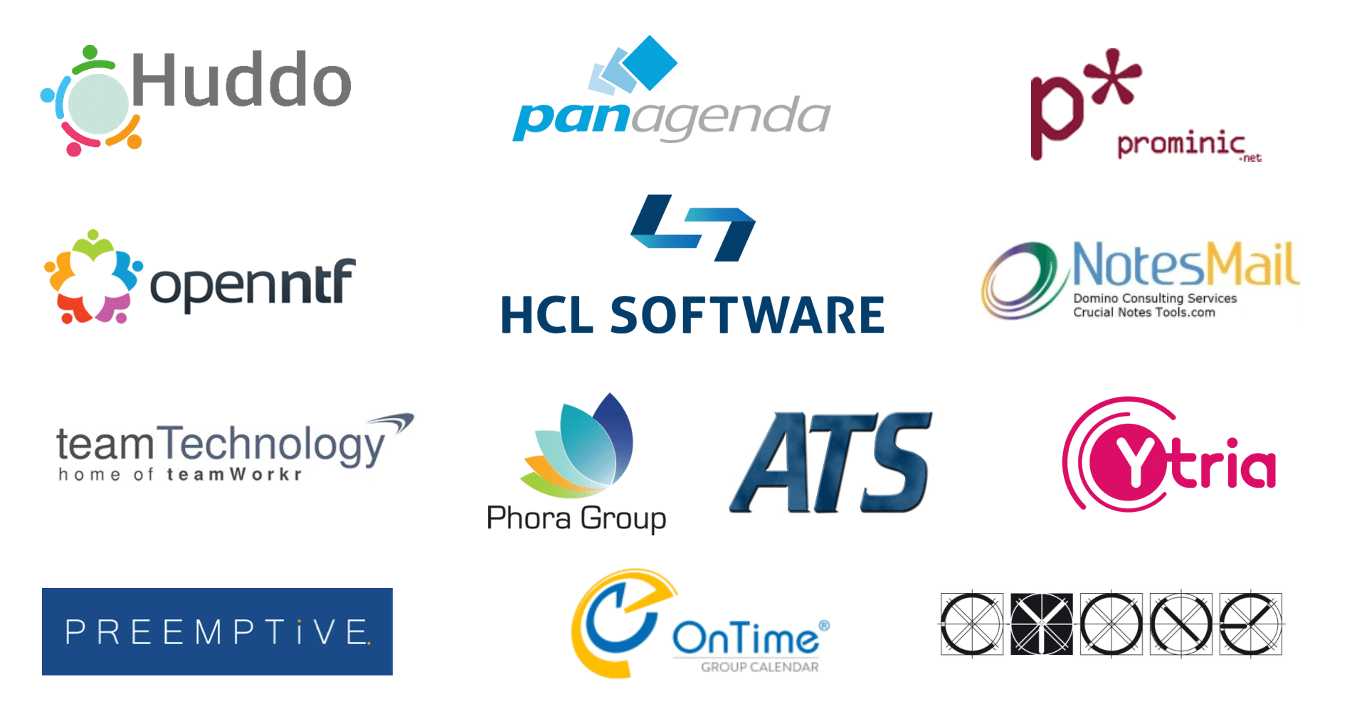

Slide 3
Presenter
Erik Werfel
Senior Software Engineer, Fragomen, Del Rey, Bernsen & Loewy
erik@werfel.net
https://github.com/ewerfel/collabsphere
https://medium.com/@erikwerfel

Slide 4
Why Jupyter Notebook
JupyterLab is a web-based interactive computing environment.
Juptyer Notebooks allow you to run code in individual cells while showing output retaining variables in memory.
Can quickly make small changes and see the effect.
Notebooks allow explanatory cells as well as code cells, and are easily shared

Slide 5
COM Objects
Uses Component Object Model
Not new technology
Windows only—Windows native technology
Notes client must be installed
Must use 32 bit COM object (to match Notes client)
All Notes objects must be derived from NotesSession (can’t instantiate other Notes objects)

Slide 6
Install Jupyter notebook
Download and install Python:
https://www.python.org/downloads/
Install Jupyter
pip install jupyterlab
Install Jupyter notebook
pip install notebook

Slide 7
Starting Jupyter
Go to the command prompt
Enter command:
jupyter notebook
Jupyter will run in current window, and should open a page in your browser

Slide 8
Necessary libraries
COM library
Python data analysis library
Library for working with scientific arrays
Library for data visualization
import win32com.client
import pandas as pd
import numpy as np
import matplotlib.pyplot as plt

Slide 9
Titanic Dataset
Titanic dataset has information about real passengers on the Titanic.
Download from:
https://www.openml.org/search?id=40945&type=data

Slide 10
Titanic Dataset
Fields in the data
Passenger Id
Survived | (0,1)
Pclass | (1,2,3)
Name
Sex | (male,female)
Age
SibSp | # of siblings or spouses on ship
Parch | # of parents or children on ship
Ticket | ticket #
Fare
Cabin
Embarked | (C,Q,S)

Slide 11
Get first document in database
notesSession = win32com.client.Dispatch('Notes.NOTESSESSION')
myDb = notesSession.GetDatabase(“[Server]", "[path\to\database]")
myview = myDb.GetView("MyView")
myDoc = myView.GetFirstDocument
Get a NotesSession COM object
Derive a NotesDatabase COM object from the session
Get a view from the database
Get the first document from the view

Slide 12
Get all items from first document
itemList = []
for i in doc.Items:
itemName = i.name
if itemName[0] != "$" and itemName != "Form":
itemList.append(itemName)
itemList
For this example, all documents in the view have the same items--that may not always be the case)
Create an empty list
Loop through all Items in the first document, adding each item name to the list

Slide 13
Retrieve all documents into a dataframe
titanicList = []
while not doc == None:
passengerDictionary = {}
for i in itemList:
passengerDictionary[i] = doc.GetItemValue(i)[0]
titanicList.append(
passengerDictionary
)
doc = view.GetNextDocument(doc)
titanicDf = pd.DataFrame(titanicList)
Create an empty list
Walk the view
For each document, create a dictionary (key/value pairs) with the name of each item and its value
Add the dictionary to the list
Make a dataframe from the list

Slide 14
Explore the dataframe
df.head(10) Show the first 10 rows
df.tail(10) Show the last 10 rows
df.shape Show the number of rows and columns
df.dtypes Show the datatype of each column
df.describe() Summarize statistical information about the dataframe

Slide 15
Examine the data
women_survival = titanicDf.loc[titanicDf.Sex == 'female']["Survived"]
# number of women who survived
rate_women = sum(women_survival)/len(women_survival)
# number of women who survived / all women
men_survival = titanicDf.loc[titanicDf.Sex == 'male']["Survived"]
# number of men who survived
rate_men = sum(men_survival)/len(men_survival)
# of women who surived / all women
dataframe.loc can take a Boolean series and filter to rows matching true values

Slide 16
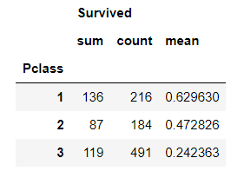
Using Groupby to categorize data
classes = titanicDf.groupby(['Pclass']).agg({'Survived':['sum','count','mean']})
Returns:
Aggregate (.agg) function applies summary operations to each group

Slide 17
Handling empty data
Filter out rows with no values:
titanicAgeDf = titanicDf[titanicDf["Age"]!=""]
Depending on circumstances, it might be preferable to substitute a value where the value is unknown, rather than filtering, but a “default” age doesn’t work here.

Slide 18
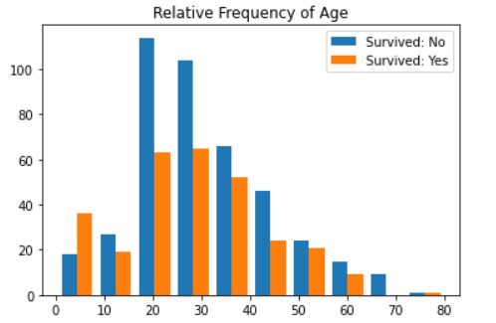
Histogram
didNotSurvive = titanicAgeDf['Age'][titanicDf['Survived']==0]
survived = titanicAgeDf['Age'][titanicDf['Survived']==1]
plt.hist([didNotSurvive,survived], label=['Survived: No','Survived: Yes'])
plt.legend(loc='upper right')
plt.title('Relative Frequency of Age');

Slide 19
Map values
lookup = {"C":"Cherbourg","S":"Southampton","Q":"Queenstown"}
titanicDf["FullEmbarked"]=titanicDf["Embarked"].replace(lookup)
Use a dictionary to map values
Use replace function to substitute value in new column

Slide 20
Update Domino with Changed Data
doc = view.GetFirstDocument
while not doc == None:
passengerId = doc.GetItemValue("PassengerId")
fullEmbarked = titanicDf[titanicDf["PassengerId"] == passengerId]["FullEmbarked"].iloc[0]
doc.ReplaceItemValue("FullEmbarked",[fullEmbarked])
doc.Save(True, True)
doc = view.GetNextDocument(doc)
Walk through documents, then find new values in dataframe by key.
Use iloc to return a string, not a series.
Use ReplaceItemValue to either replace an item or add a new item.

Slide 21
Save to Excel
Use dataframe.to_excel to save to an Excel workbook. Only the filename/path is required.
destFile = r'C:\Users\ewerfel\Documents\Collabsphere\titanic.xlsx'
titanicDf.to_excel(destFile)

Slide 22
Populate a Domino application
First read in from source to dataframe
sourceFile = r'C:\Users\ewerfel\Documents\Collabsphere\titanic.csv'
titanicDataFrame = pd.read_csv(sourceFile, header=0, keep_default_na=False)
# Age includes some empty values, which forces the column to string. to_numeric will change column to numeric.
titanicDataFrame["Age"] = pd.to_numeric(titanicDataFrame["Age"], errors="coerce")
# fillna will change values that couldn't convert to numeric to the empty string, rather than NaN, which Domino can't use
titanicDataFrame = titanicDataFrame.fillna('')

Slide 23
Populate a Domino application part 2
Then create a document for each row in the dataframe.
notesSession = win32com.client.Dispatch(r'Notes.NOTESSESSION')
collabsphereDb = notesSession.GetDatabase("[server]", "[path]")
formName = "Passenger"
for index, row in titanicDataFrame.T.items():
doc = collabsphereDb.CreateDocument
doc.ReplaceItemValue("Form",formName)
for i in range(len(row)):
doc.ReplaceItemValue(row.index[i], row[i])
doc.Save(1,1)

Slide 24
Populate a Domino application part 2
Then create a document for each row in the dataframe.
notesSession = win32com.client.Dispatch(r'Notes.NOTESSESSION')
collabsphereDb = notesSession.GetDatabase("[server]", "[path]")
formName = "Passenger"
for index, row in titanicDataFrame.T.items():
doc = collabsphereDb.CreateDocument
doc.ReplaceItemValue("Form",formName)
for i in range(len(row)):
doc.ReplaceItemValue(row.index[i], row[i])
doc.Save(1,1)

Slide 25
Presenter
Erik Werfel
Senior Software Engineer, Fragomen, Del Rey, Bernsen & Loewy
erik@werfel.net
https://github.com/ewerfel/collabsphere
https://medium.com/@erikwerfel

